Slide 1
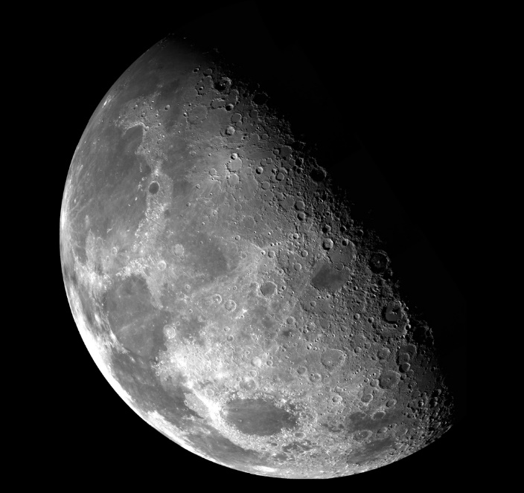
Verso la Generazione del Villagio Lunare
by Ing. Giuseppe Reibaldi Presidente
^{Liceo Scientifico A.Einstein}
^{Cerignola} 20 Gennaio 2022

Slide 2
WHAT IS THE MOON VILLAGE ?
IS …
An ensemble of global efforts: governmental, private and general public
Exploring and using the moon resources in cooperation and in sustainable manner
A Lunar Community on the surface and cis-lunar space
IS NOT …
An “ISS on the Moon”
A literal village
A single science facility
pg 2

Slide 3
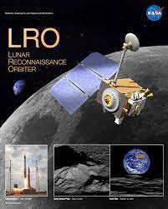
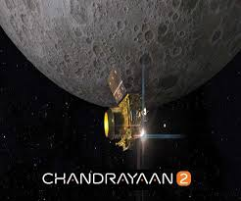
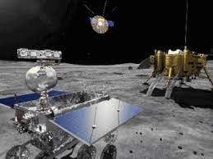
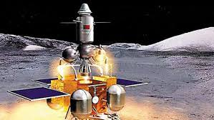
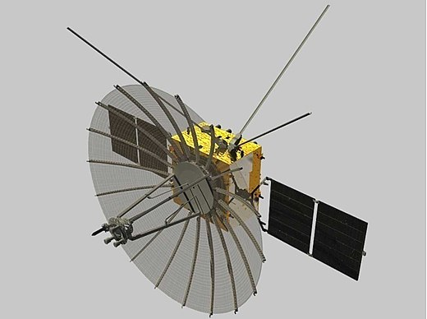
HOW MANY MISSIONS ARE ACTIVE ON/AROUND THE MOON??
1) Lunar Reconnaissance Orbiter (O) -US
2) Chandrayan-2 (0) - India
3) Chang’e-4, Rover (Yutu2) China
4) Queqiao, Relay Satellite (O), China
5) Chang’e-5, China

Slide 4
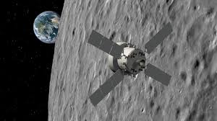
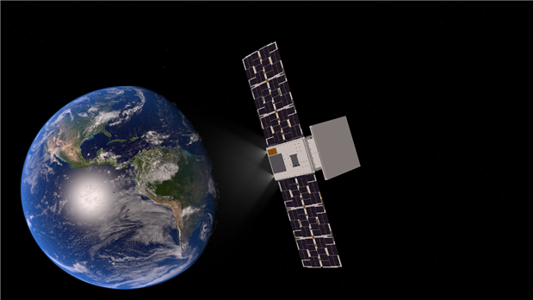
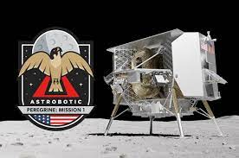
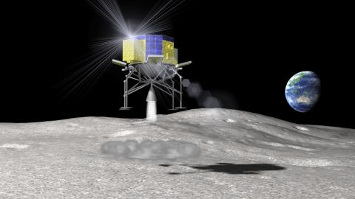
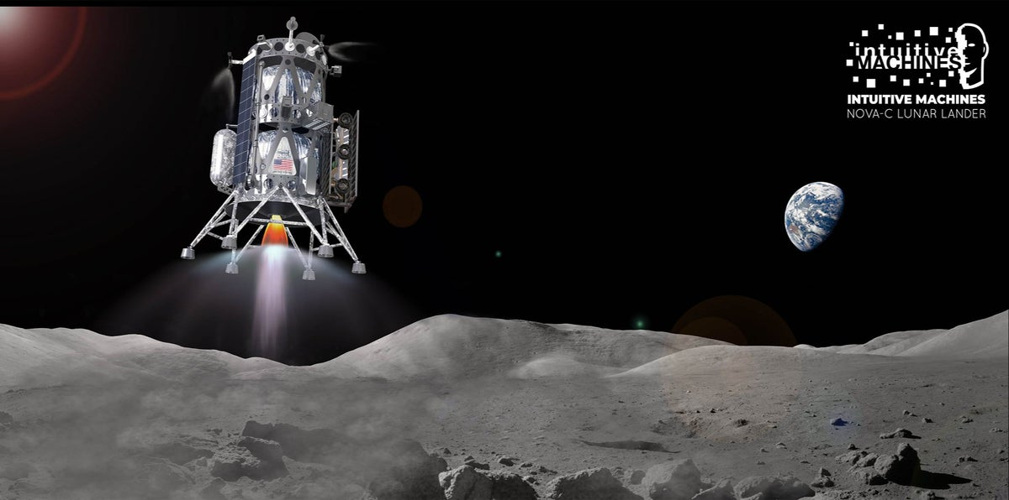
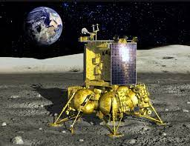
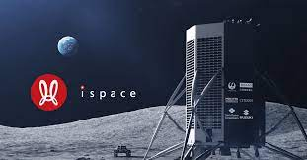
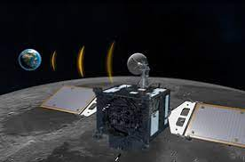
HOW MANY MISSIONS TO THE MOON IN 2022??
1)Artemis 1, (O)- US
2)CAPSTONE, (O) -US
3) Smart Lander for Investigating Moon -JAPAN
4) Intuitive Machines 1 - US
5) Astrobotic, Peregrine 1 - US
6) Luna-25 - Russia
7) Ispace Hakuto-R - Japan
8) Korea Pathfinder Lunar Orbiter. (O) - Korea
9) Chandrayan-3 - India

Slide 5
WHAT IS THE MOON VILLAGE ASSOCIATION ?
The Moon Village Association (MVA) created in June 2017,
to foster the implementation of the Moon Village.
MVA is Member of IAF and Observer in United Nations - COPUOS
A forum to advance development of the Moon Village involving Industry, government, space agencies, international organizations / NGOs, and the Public at large.
A catalyst stimulating a virtuous cycle of investments for the development of a lunar economy
800 INDIVIDUALS INVOLVED FROM 60 COUNTRIES:
- 25% women
- 24% students
- 38% young professionals
>23 INSTITUTIONAL MEMBERS
FROM 17 COUNTRIES

Slide 6
MOON VILLAGE IMPLEMENTATION -Working Groups/Projects-
Participation of
Emerging
Space
Countries
-PECS-
Analogue
Architecture
Concepts
Outreach/
Education/
Women
on the Moon
Coordination&
Cooperation
Lunar Commerce
And
Economics
First Payload
Cultural
Considerations

Slide 7
Moon Village 2045 Reference Concept

Slide 8
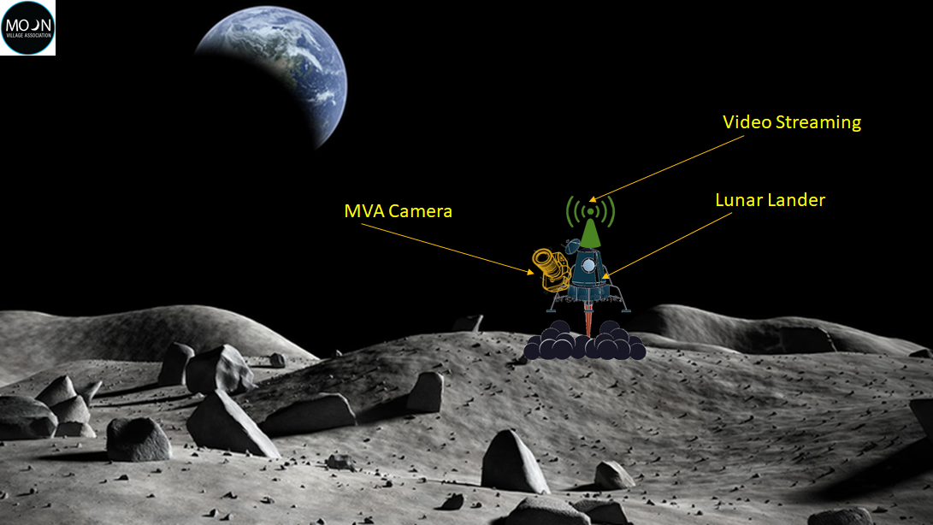
Payload Project
- The Project is involving a global
industrial consortium from:
CH, UK, Mexico, India, UAE, Egypt
- More countries are welcome
- MVA is seeking for the Lunar Lander carrier

Slide 9
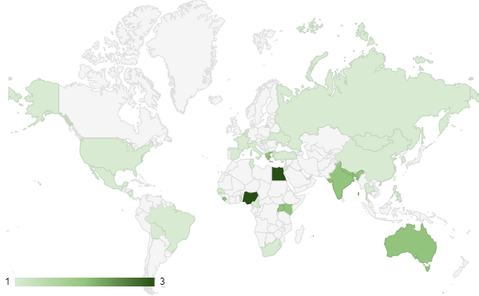
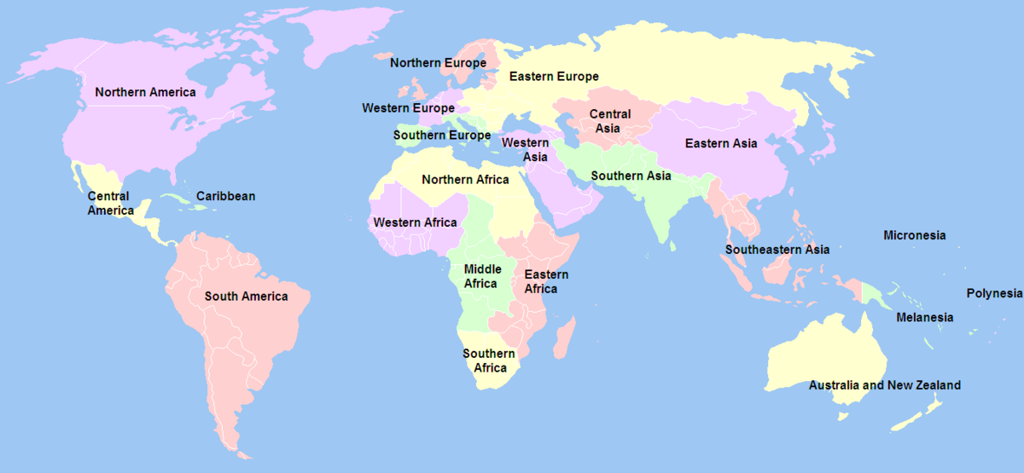
Global Network
50 national coordinators and 6 regional coordinators
Call for new National and Regional Coordinators Open
Europe and Asia

Slide 10
Some of the Recent Activities
Jordan: Spacesuit and rover competition
Italy: Thursday of Galassica
Egypt: Social media promotion, SG[Egypt]
Africa: has been focused on recruitment
Greece: Moon 2069 – A way forward

Slide 11
TOWARDS THE LUNAR GENERATION WORKSHOP July 2021
Sponsors and Partners

Slide 12
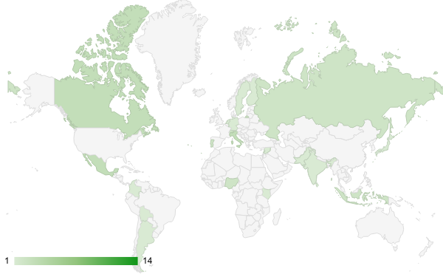
Overview
Average age: 26
28 countries
49% students
67 participants
12 team members
113 applications
Towards a Lunar Generation Workshop
https://moonvillageassociation.org/tlg2021/
- Lunar Medical Autonomy
- Legal status and policy issues in Moon resource
and Infrastructure development and utilization
- Innovation Craters Hackathon
- Moon as a base for science
- Technologies for a sustainable Moon village
6
speakers
20+ experts
5 discussion groups

Slide 13
Discussion Groups
Lunar Medical Autonomy
Infrastructure
High risk medical emergencies, and how can they be tackled
Major human factors (including mental health) challenges on the Moon
Role of analogues
Legal and Policy Issues of Resource Utilization and Infrastructure
Main challenges and obstacles to a legal framework
Sharing of resources and infrastructure be shared between various stakeholders
Reducing the risk of unpeaceful interactions on the Moon
Hackathon focused on developing business ideas for lunar Explorations in the year 2030.
Science on the Moon
Scientific objectives beyond current objectives
Manned missions vs robotic missions
Role of (a permanent) human settlement on the Moon in scientific advancement
Technologies for a sustainable Moon Village
Main enabling technologies for operation on the Moon and their TRL
Role of emerging technologies
Role of emerging space countries
5, 10 and 50 year horizons
Role of the MVA and SGAC

Slide 14
New MVA Project: Towards a Moon Village Generation
Project started last September:
Website is live and we are looking for volunteers!
Next topics Workshop will be related to:
Role of Emerging Space Countries
Science Communication and the Role of the Arts
Equity, Diversity and Inclusion in the Moon Village
Schools involvement play an important role
Possibility to ask Questions/make proposal to MVA

Slide 15
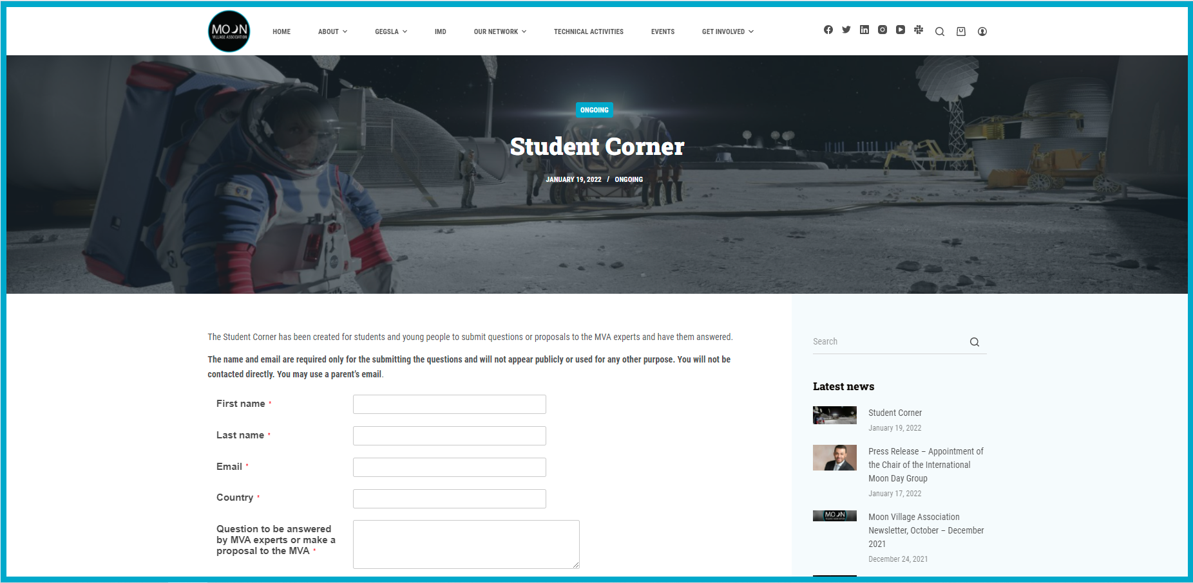
THANK YOU FOR YOUR ATTENTION
www.moonvillageassociation.org

Slide 16
THANK YOU FOR YOUR ATTENTION
www.moonvillageassociation.org

